Slide 1

DETECTING PERSON OF Interest IN A GIVEN VIDEO FILE
DONE BY,
JACOB BRYAN THOMAS
JASSEM MOHAMMED
NILESH YAWATKAR
ROHIT

Slide 2
CONTENTS
1. Main Objective
2. Data Gathering
3. Convolutional Neural Networks
4. Multi-Task Cascade Neural Network (MTCNN)
5. Facenet Model
6. Face Embedding
7. Triplet Loss
8. Comparing the Embeddings
9. Implementation
10. Future Work and Difficulties faced
11. References
12. Thank You

Slide 3
Main Objective
To detect a person of interest from the given input video and to check if he is present in the other video files (eg. CCTV footages).
This will help us in being able to separate the relevant videos in which the person of interest is present out of a big pool of videos which we can aid us track more efficiently.

Slide 4
Data gathering
1. Pre-trained FaceNet model
This Pre-trained FaceNet model was made by Hiroki Taniai which can be loaded using Keras. It was trained on MS-Celeb-1M dataset and expects input images to be color.
2. Anchor Images
3. Videos

Slide 5
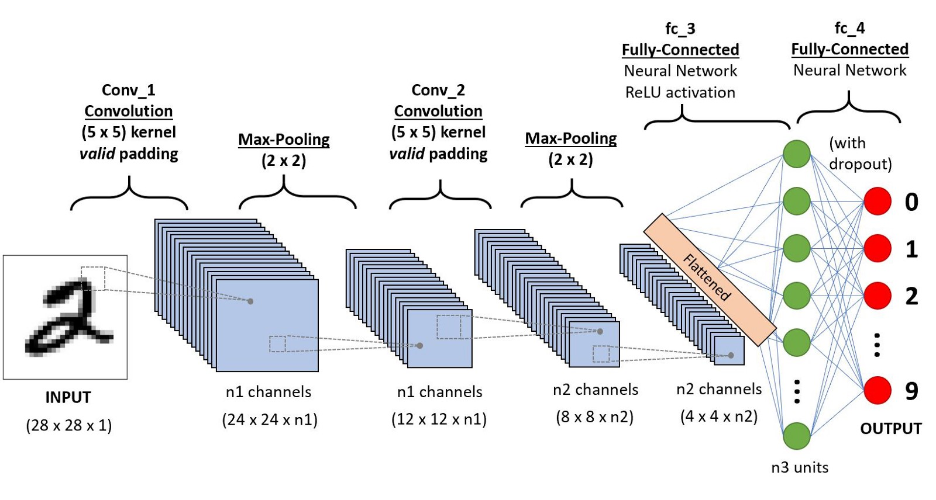
Convolutional neural networks

Slide 6
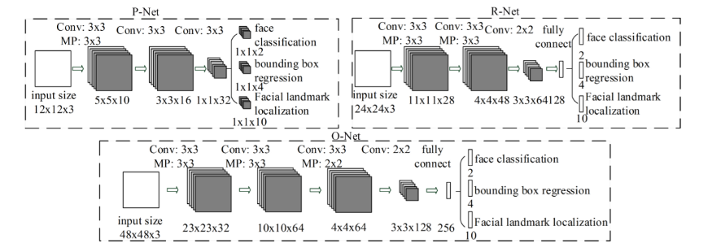
MULTI-TASK CASCADE NEURAL NETWORK (MTCNN)

Slide 7
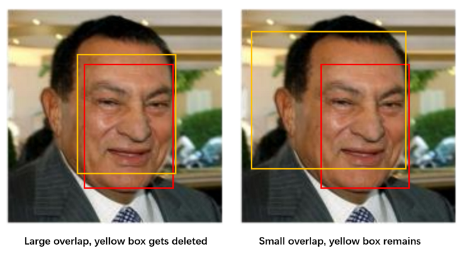
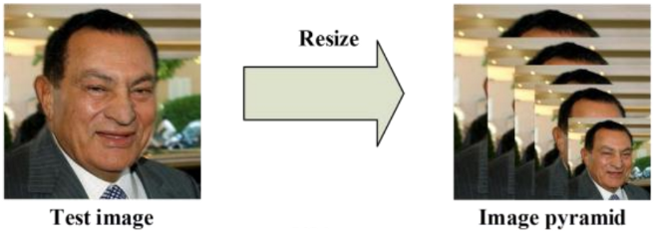
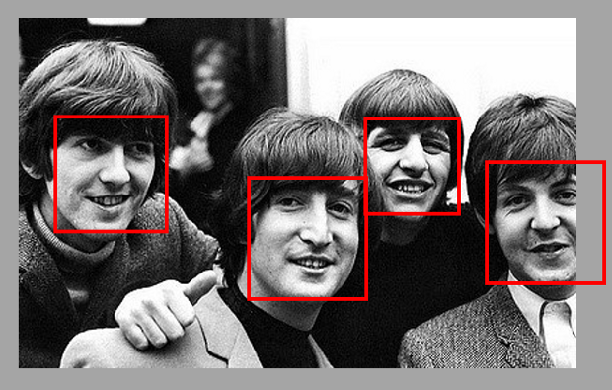

Slide 8
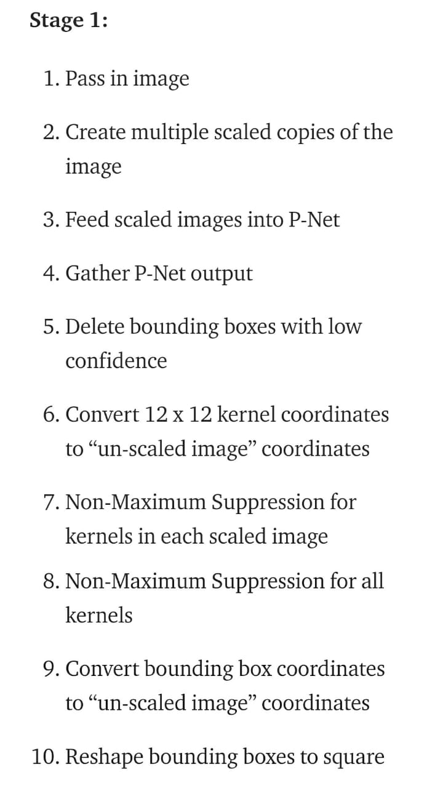
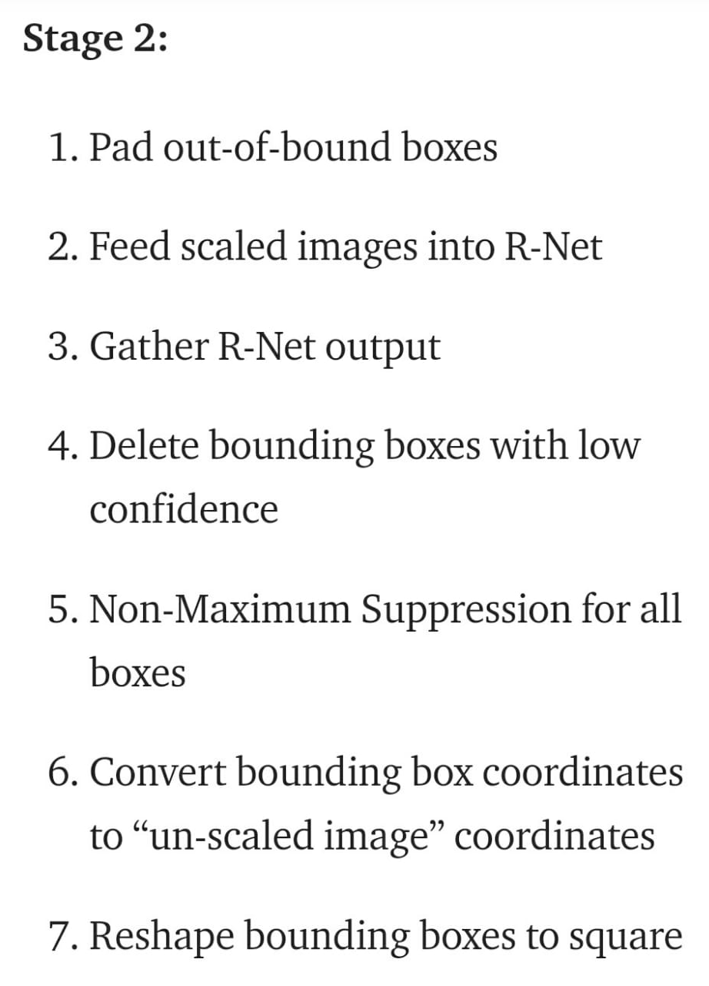
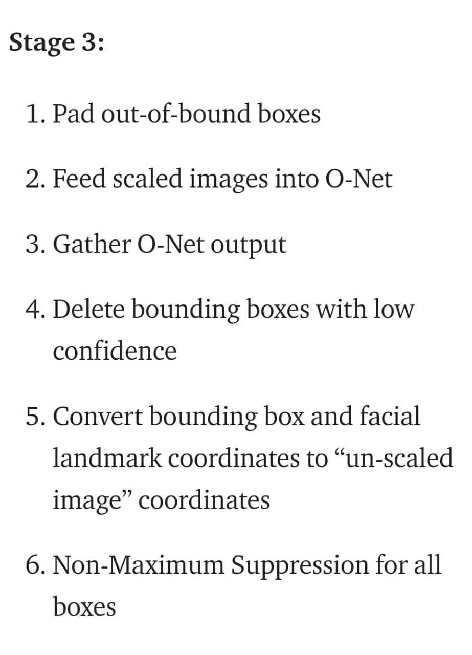

Slide 9
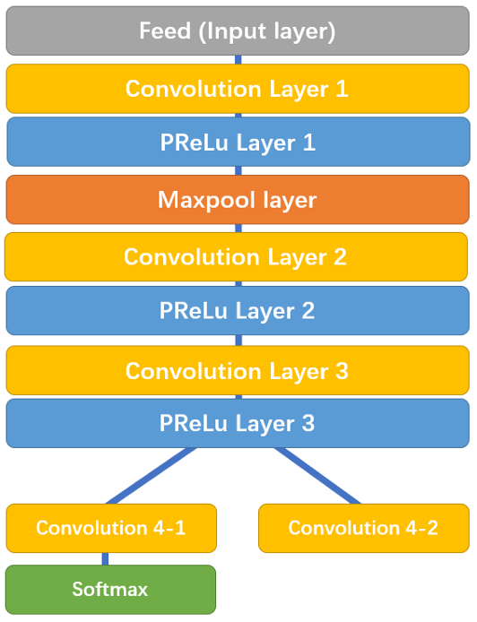
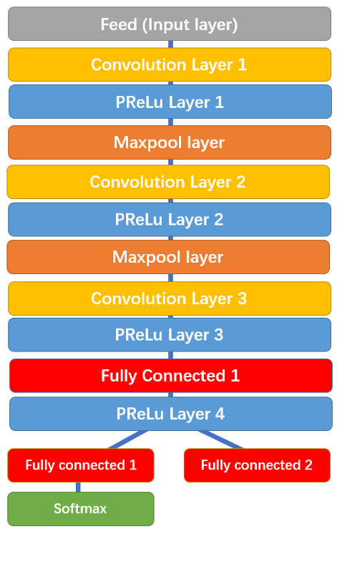
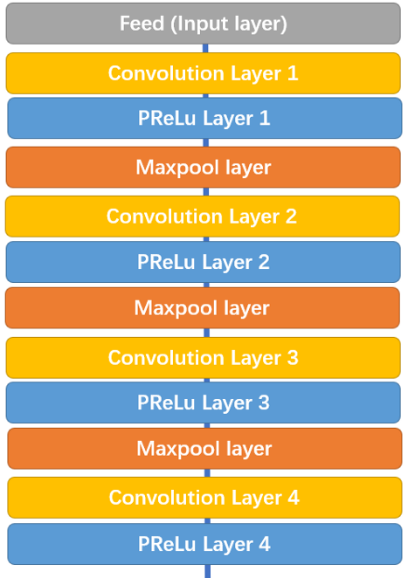
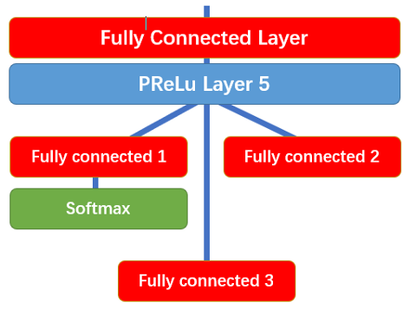
MULTI-TASK CASCADE NEURAL NETWORK (MTCNN)
p-net
r-net
o-net

Slide 10
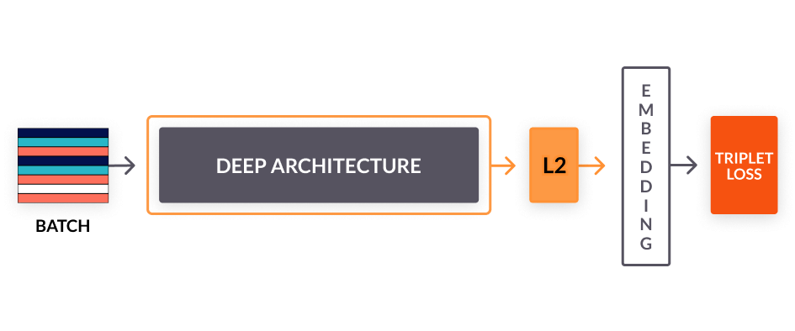
Facenet model

Slide 11
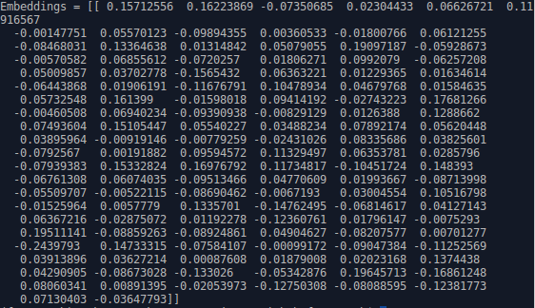
Face embedding
It is a multidimensional numerical vector that represents the unique identity of the face.

Slide 12
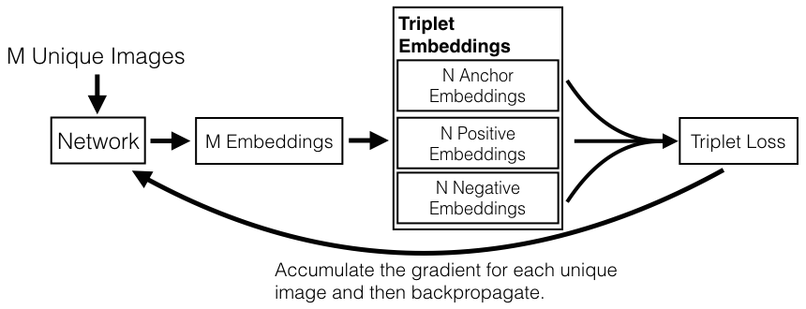
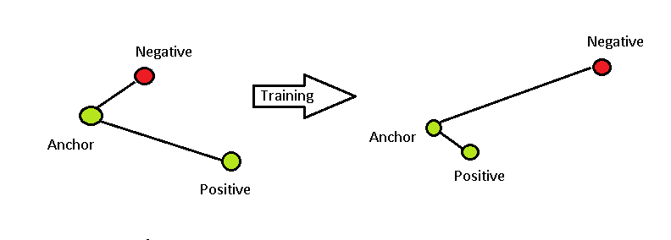
Triplet loss
The goal of the triplet loss is to make sure that:
1. Two examples with the same label have their embeddings close together in the embedding space
2. Two examples with different labels have their embeddings far away.

Slide 13
Implementation (part 1)
VIDEO FILES
Split into frames
MTCCN
Faces are extracted.
Pre-Trained Facenet model
Resized faces are passed as input to the Facenet model and 128 length Face embedding vectors are generated and saved to file.
Resized into 160x160 pixels
They converted to numpy array and saved.

Slide 14
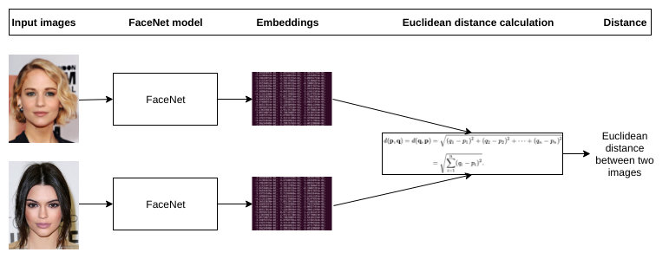
Comparing the embeddings

Slide 15
Implementation (part 2)
If noOfAnchorImages is 1:
Euclidean distance computation
Verifying if there are matching faces using a threshold distance measure.
Build a ML classifier model using the embeddings
Verifying if there are matching faces using the ML classifier.

Slide 16
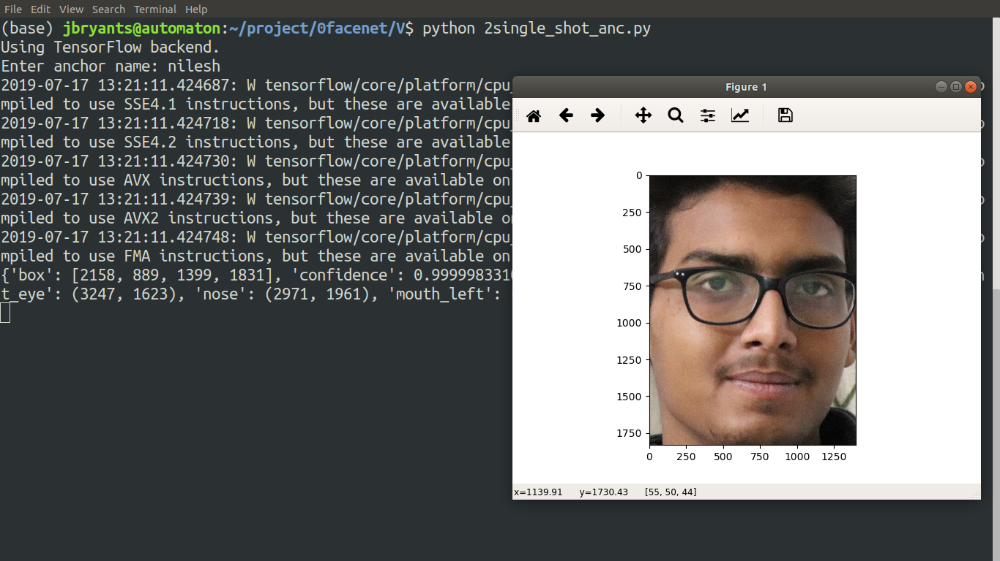
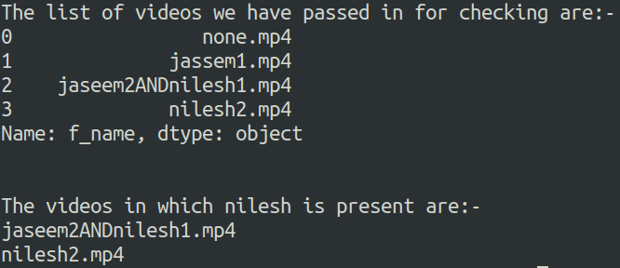
Test-1

Slide 17
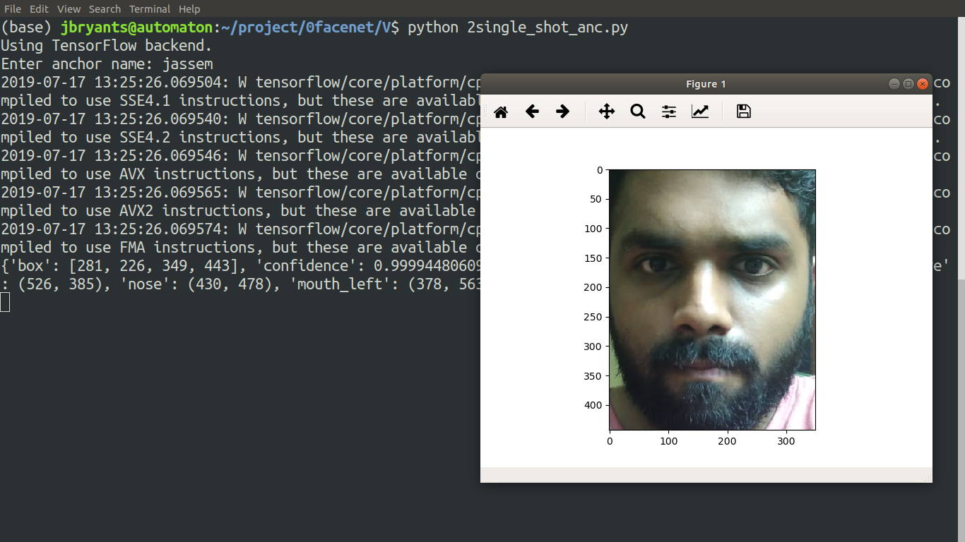
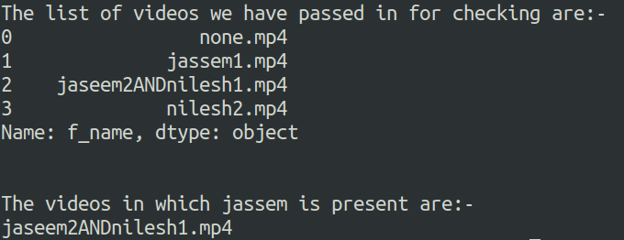
Test-2

Slide 18
Future work and difficulties faced

Slide 19
references
FaceNet: a unified embedding for face recognition and clustering by Florian Schroff (Google Inc.)
https://towardsdatascience.com/face-detection-neural-network-structure-257b8f6f85d1
https://towardsdatascience.com/how-does-a-face-detection-program-work-using-neural-networks-17896df8e6ff
https://www.pytorials.com/face-detection-matching-using-facenet/

Slide 20

THANK YOU

